Slide 1

REGISTER FILE
Aim of the Experiment:
To construct a register file, from which two 16-bit values can be read, and to which one 16-bit value written, every clock cycle.

Slide 2
Introduction to Register File
In a modern computer, it typically takes hundreds of clock cycles to fetch data from main memory to the microprocessor
If the ALU in the microprocessor operated directly on data from memory, it would spend most of its time waiting.
To achieve high performance, microprocessors incorporate a register file.
The register file, a key component of microprocessors, is a bank of registers used as a temporary high-speed storage into which data is fetched from memory.
The register file then provides inputs to the ALU.
As you may recall, in assignment 2 you constructed an ALU that received two 16-bit inputs and produced one 16-bit output.

Slide 3
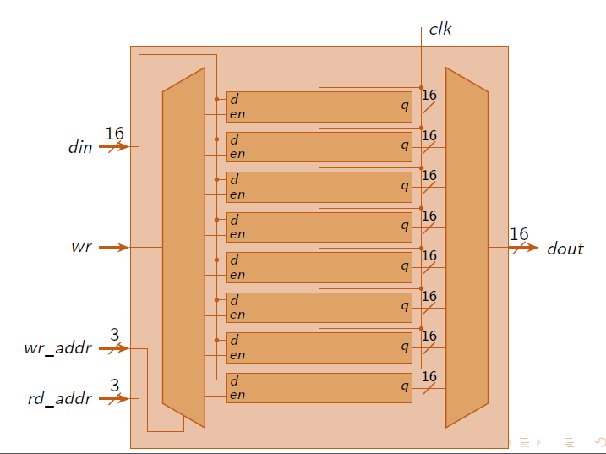
Register Files or Memory Array

Slide 4
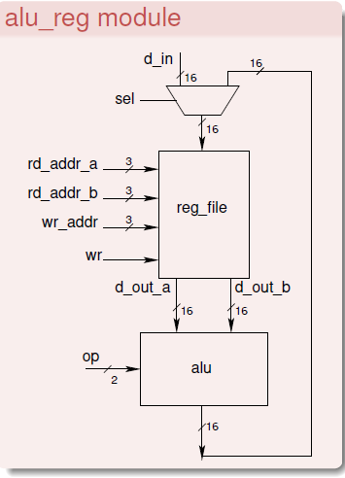
Register File Specification
The register file should make it possible to simultaneously read from two registers and write into one register.
Therefore, the register file requires two read ports and one write port.
The register file should contain eight(16-bit) registers.
Each of the read and write ports need to be able address any of the eight registers.
Register address varies from 0 to7
Hence each of the two read addresses and one write address needs to be three bits wide.

Slide 5
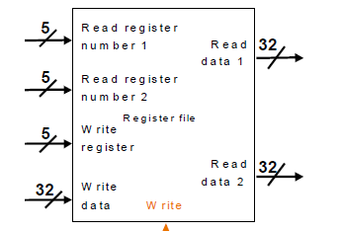
Register File Specification
Also, register 0 should always be zero
When register address 0 is supplied on any of the read ports, the corresponding output should be zero
When register address 0 is supplied on the write port, the corresponding input data should be ignored (not written to any register).

Slide 6
Register File Inputs and Outputs
The inputs to the register file are Clk reset wr rd_addr_a[2:0]//3bit rd_addr_b[2:0] wr_addr[2:0] d_in[15:0] | The outputs to register file are d_out_a[15:0] d_out_b[15:0] Read port a(rd_addr_a and d_out_a) Read port b (rd_addr_b and d_out_b) Write Port(wr, wr_addr and d_in)

Slide 7
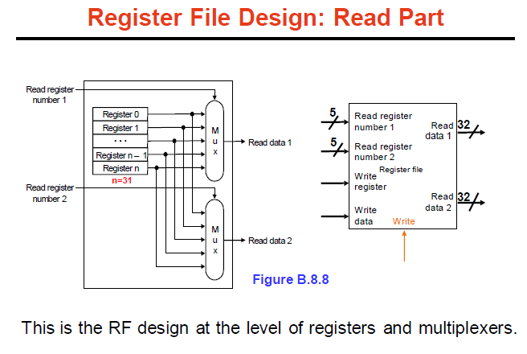
For port a, the address of the register to be read is applied to rd_addr_a
At the next positive clock edge, the contents of the corresponding register should be available on d_out_a.
Port b should operate in the same manner.

Slide 8
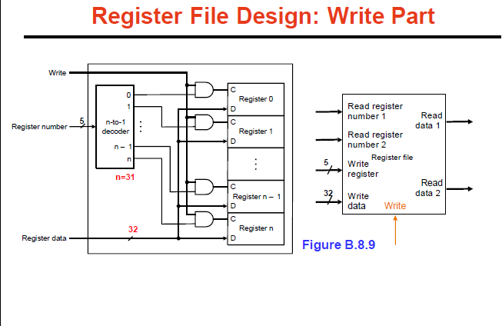
When wr is high, the value applied to d_in should be stored in the register whose address is specified by wr_adder, at the next clock positive clock edge.
When wr is low, inputs d_in and wr_adder should be ignored.
So in this manner the register file should be able to perform two read operations and one write operation (if wr is high) every clock cycle.

Slide 9
Library Function already defined in lib.v
module mux2 (input wire i0, i1, j, output wire o);
module mux4 (input wire [0:3] i, input wire j1, j0, output wire o);
module mux8 (input wire [0:7] i, input wire j2, j1, j0, output wire o);
module demux2 (input wire i, j, output wire o0, o1);
module demux4 (input wire i, j1, j0, output wire [0:3] o);
module demux8 (input wire i, j2, j1, j0, output wire [0:7] o);
module df (input wire clk, in, output wire out);
module dfr (input wire clk, reset, in, output wire out);
module dfrl (input wire clk, reset, load, in, output wire out);

Slide 10
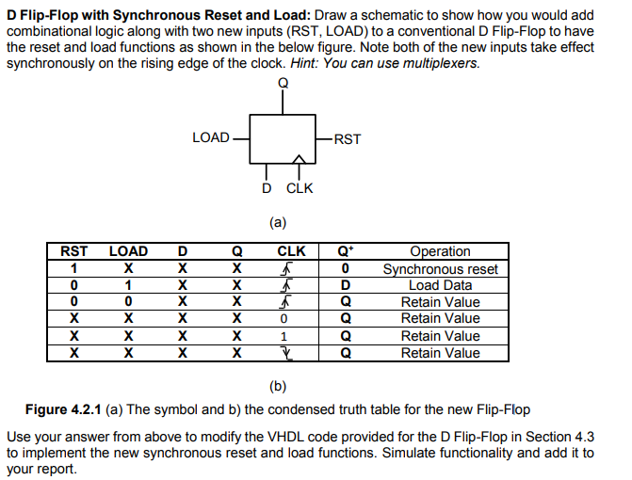
Working of D Flip Flop with
synchronous Reset and Load
RST | LOAD | D | Q | CLK | Q+ | Operation
1 | X | X | X | Positive Edge | 0 | Synchronous Reset
0 | 1 | 0 | X | Positive Edge | D=0 | Load Data
0 | 1 | 1 | X | Positive Edge | D=1 | Load Data
0 | 0 | X | X | Positive Edge | Q | Retain Value
X | X | X | X | Positive Edge | Q | Retain Value
X | X | X | X | 0 | Q | Retain Value
X | X | X | X | 1 | Q | Retain Value
X | X | X | X | Positive Edge | Q | Retain Value

Slide 11
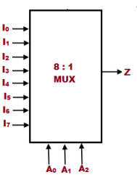
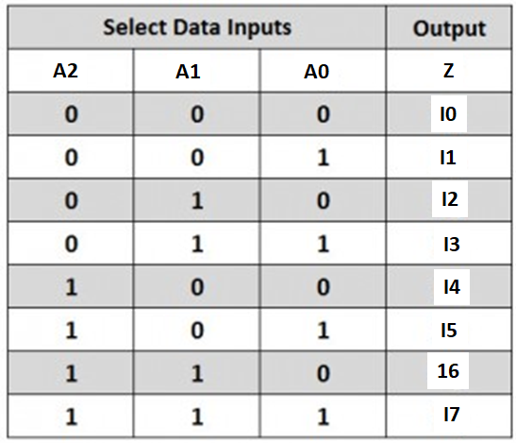
Working of 8:1 Multiplexer

Slide 12
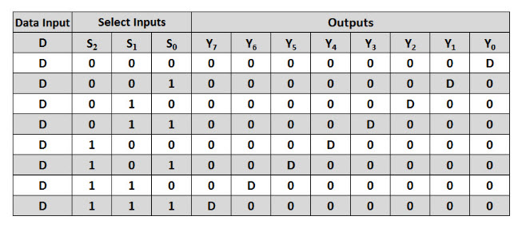
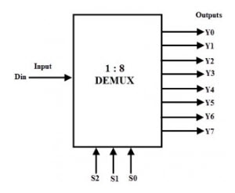
Working of 1:8 Demultiplexer

Slide 13
Building the Register File
You can construct the registers using the dfrl flip flop (positive edge triggered D flip flop with reset and load enable) supplied in lib.v.
All dfrl clock and reset inputs should be connected to the global clock and reset inputs supplied to the reg file module.

Slide 14
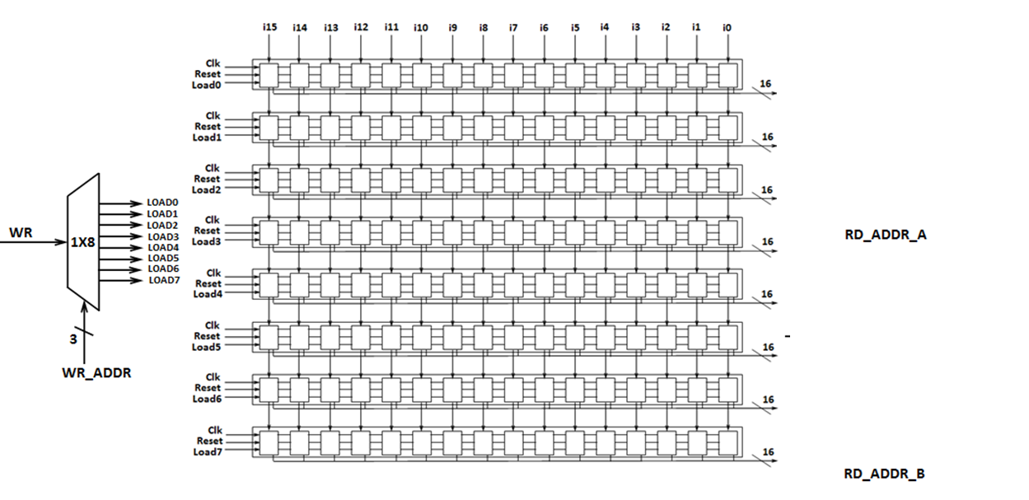
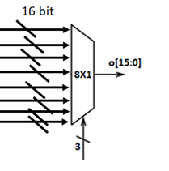
Register Files or Memory Array

Slide 15
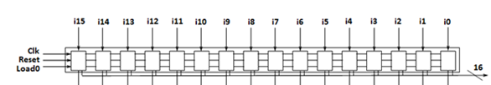
// MODULE 1 regfile.v
module dfrl_16 (input wire clk, reset, load, input wire [15:0] in, output wire [15:0] out);
dfrl _f0(clk, reset, load, in[0],out[0]);
dfrl _f1(clk, reset, load, in[1],out[1]);
dfrl _f2(---------------------------------------------------------------------------------);
---------------------------------------------------------------------------------------------
---------------------------------------------------------------------------------------------
---------------------------------------------------------------------------------------------
---------------------------------------------------------------------------------------------
---------------------------------------------------------------------------------------------
dfrl _f15(-----------------------);
endmodule;

Slide 16
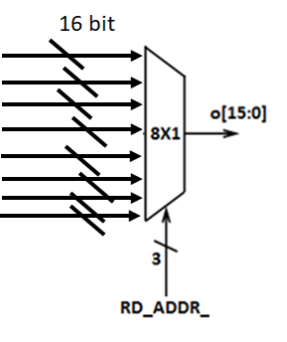
// MODULE 2 regfile.v
module mux8_16 (input wire [0:15] i0, i1, i2, i3, i4, i5, i6, i7, input wire [0:2] j, output wire [0:15] o);
mux8 mux8_0({i0[0], i1[0], i2[0], i3[0], i4[0], i5[0], i6[0], i7[0]}, j[0], j[1], j[2], o[0]);
mux8 mux8_1({-------------------------);
mux8 mux8_2({--------------------------);
mux8 mux8_3({-------------------------);
----------------------------------------------------------------------------------------------------------------------------------------------------------------------------------------------------------------------------------------------------------------------------------------------------------------------------------------------------------------------------------------------------------------------------------------------------------------------------mux8 mux8_15({-----------------------------);
endmodule

Slide 17

// MODULE 3 regfile.v
module reg_file (input wire clk, reset, wr,
input wire [0:2] rd_addr_a, rd_addr_b, wr_addr,
input wire [0:15] d_in, output wire [0:15] d_out_a, d_out_b);
dfrl_16 dfrl_16_0(clk, reset, load[0], d_in, dout_0);
dfrl_16 dfrl_16_1
dfrl_16 dfrl_16_2-----------------------------------------------------------
----------------------------------------------------------------------------------
---------------------------------------------------------------------------------
dfrl_16 dfrl_16_7(clk, reset, load[7], d_in, dout_7);

Slide 18
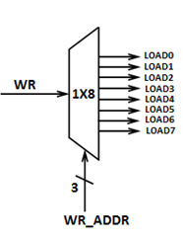
// MODULE 3 regfile.v
demux8 demux8_0(wr, wr_addr[2], wr_addr[1], wr_addr[0], load);
mux8_16 mux8_16_9(dout_0, dout_1, dout_2, dout_3, dout_4, dout_5, dout_6, dout_7, rd_addr_a, d_out_a);
mux8_16 mux8_16_10(-----------------------------------------------------------------------------------------------------d_out_b);
endmodule

Slide 19
wr | rd_addr_a |  |  | rd_addr_b |  |  | wr_addr |  |  | d_in | Output
25 | 24 | 23 | 22 | 21 | 20 | 19 | 18 | 17 | 16 | Bit15 to Bit 0
1 | x | x | x | x | x | x | 0 | 1 | 1 | CDEF | Reg3=CDEF
1 | x | x | x | x | x | x | 1 | 1 | 1 | 3210 | Reg7=3210
1 | 0 | 1 | 1 | 1 | 1 | 1 | 1 | 0 | 1 | 4567 | Reg5=4567
1 | 0 | 0 | 1 | 1 | 0 | 1 | 0 | 0 | 0 | BA98 | Reg0=BA98
0 | 0 | 0 | 1 | 1 | 0 | 1 | 0 | 0 | 1 | xxxx | d_out_a= d_out_b=
0 | 0 | 0 | 0 | 0 | 0 | 0 | x | x | x | xxxx | d_out_a= d_out_b=

Slide 20
Design and Simulation
The reg_file module can be tested using the supplied tb_reg_file.v with the commands:
iverilog -o tb_reg_file lib.v alu.v reg_alu.v tb_reg_file.v
vvp tb_reg_file
gtkwave tb_reg_file.vcd
Students have to submit 6 screenshots ,one for each of the test cases in the truth table.

Slide 21
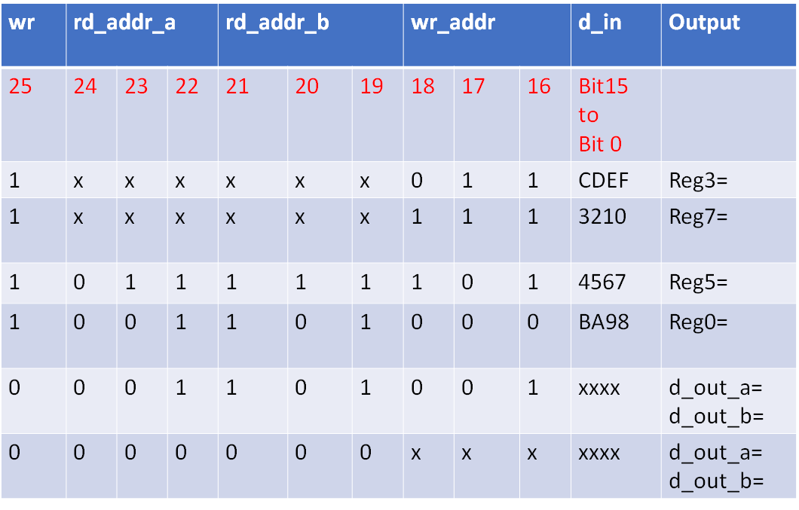
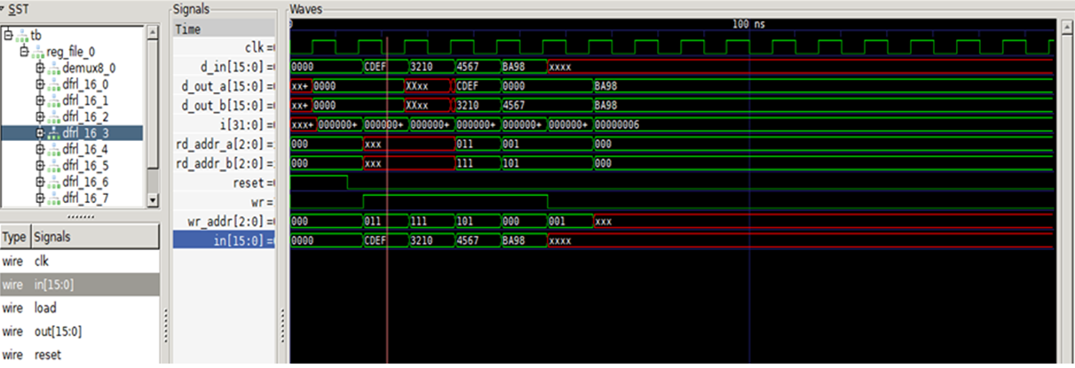
SAMPLE SCREENSHOT-1
CASE1 (write operation):
wr=1 ,Write Address=011,d_in=CDEF
Verify in the waveform that
in[15:0] of Register 3=CDEF

Slide 22
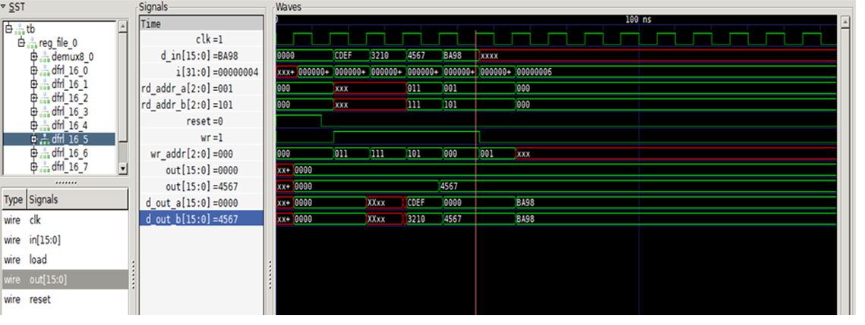
SAMPLE SCREENSHOT-2
CASE 5 (read operation):
wr=0 ,rd_addr_a=001,rd_addr_b=101 Verify in the waveform that
out[15:0] of Register 1=d_out_a ,
out[15:0] of Register 5=d_out_b

